Slide 1


Bangalore Institute Of Technology
Department of Information Science and Engineering
Software Testing Lab (21ISL66)
Selenium Script
Automated Testing for ``maxfashion.in``
Faculty Incharge-
Dr. M Shilpa
Associate professor
Dept. of ISE
Presented By-
Kiran K (1BI21IS042)
Lovelesh Debnath (1BI21IS049)

Slide 2
ABSTRACT
Software testing: Systematic process of evaluating software to identify defects and ensure quality
Critical in software development lifecycle for reliability and user satisfaction
Selenium: Open-source tool for automating web browsers
Enables efficient, repeatable testing of web applications

Slide 3
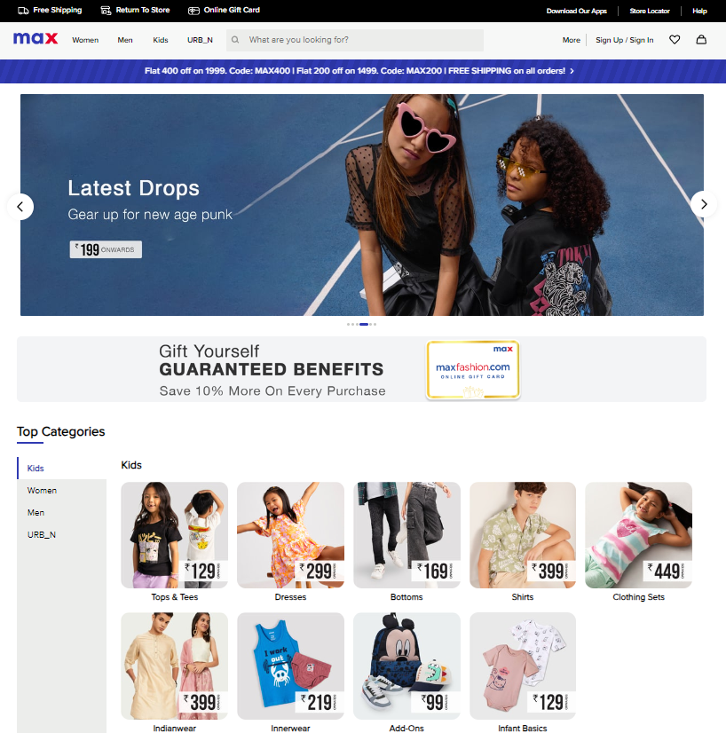
Introduction to MAX Website
MAX: Popular clothing brand with e-commerce presence
Website crucial for brand visibility and sales
Reliable functionality essential for positive user experience and business success

Slide 4
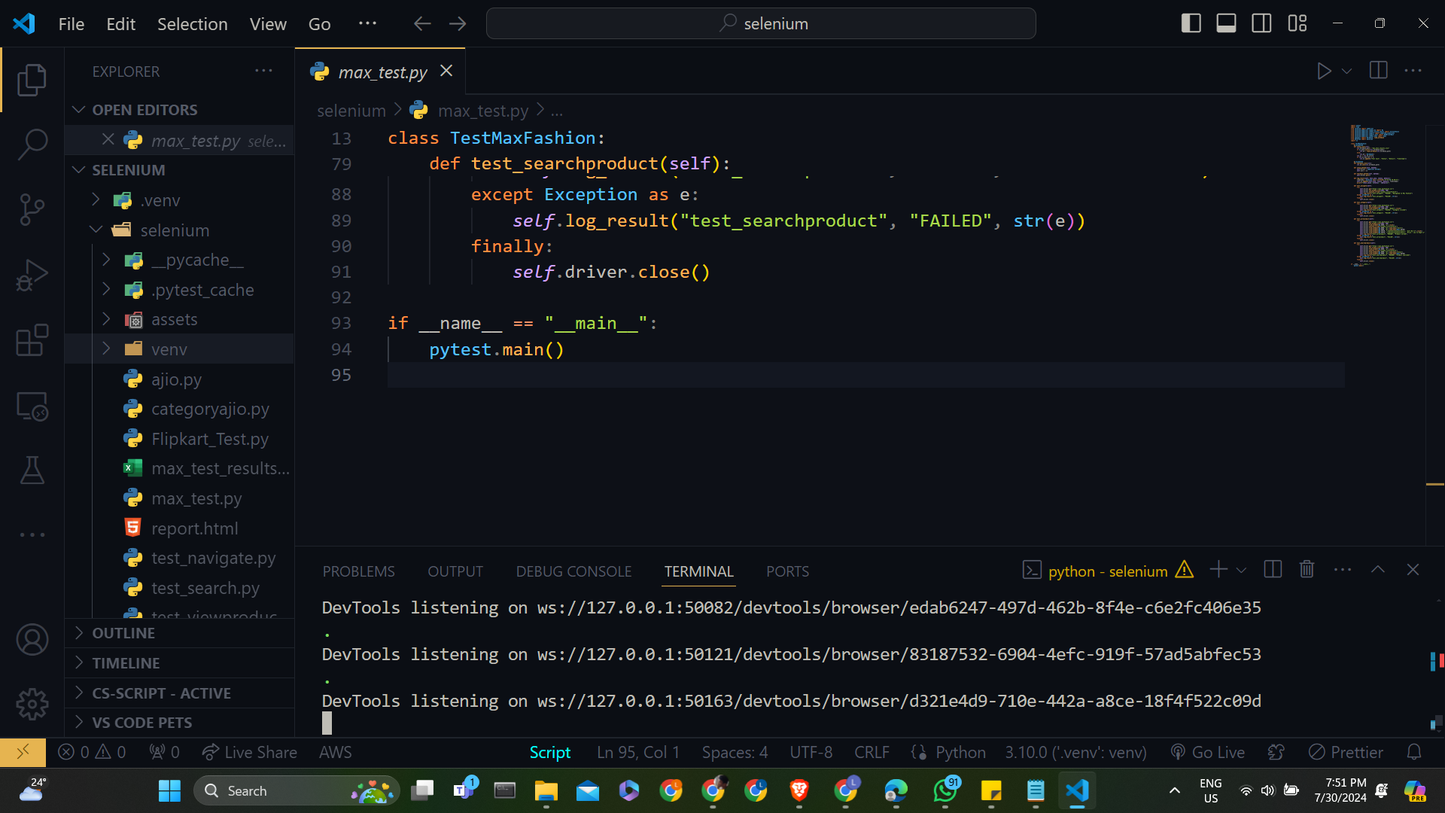
Objectives of Testing
Ensure consistent website performance across different scenarios
Verify key features:
Navigation: Smooth movement between pages
Search: Accurate and fast results
FAQs: Accessible and informative
Improve user experience by identifying and resolving issues

Slide 5
Selenium WebDriver
Test Environment
Selenium WebDriver: Tool for automating web browser interaction
Advantages:
Cross-browser compatibility
Support for multiple programming
Ability to mimic real user actions
Python integration: Combines Selenium's power with Python's simplicity
Visual Studio Code: Lightweight, powerful IDE for Python
Python: Versatile programming language, ideal for test automation
Selenium WebDriver setup:
Installation via pip
WebDriver configuration for chosen browser (e.g., ChromeDriver)

Slide 6
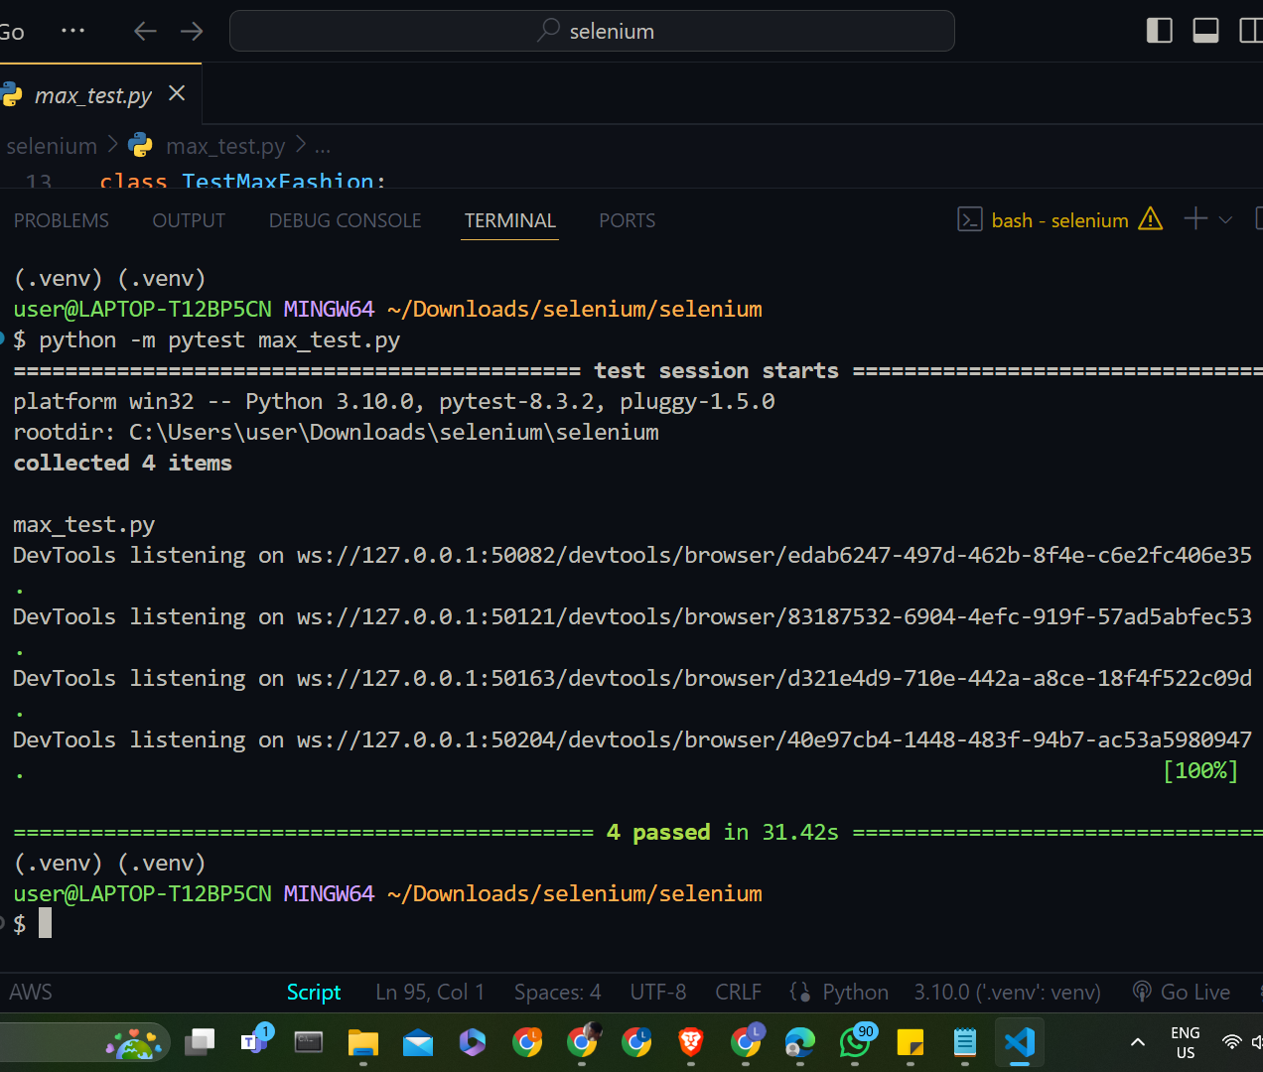
Test Scenarios
Navigation testing:
Verify main menu links
Check breadcrumb functionality
Search functionality:
Validate search functionality for specific items
Validate search results accuracy
Product sorting:
Check functionality of sorting products by price
Category browsing:
Test navigation to the Women's category

Slide 7
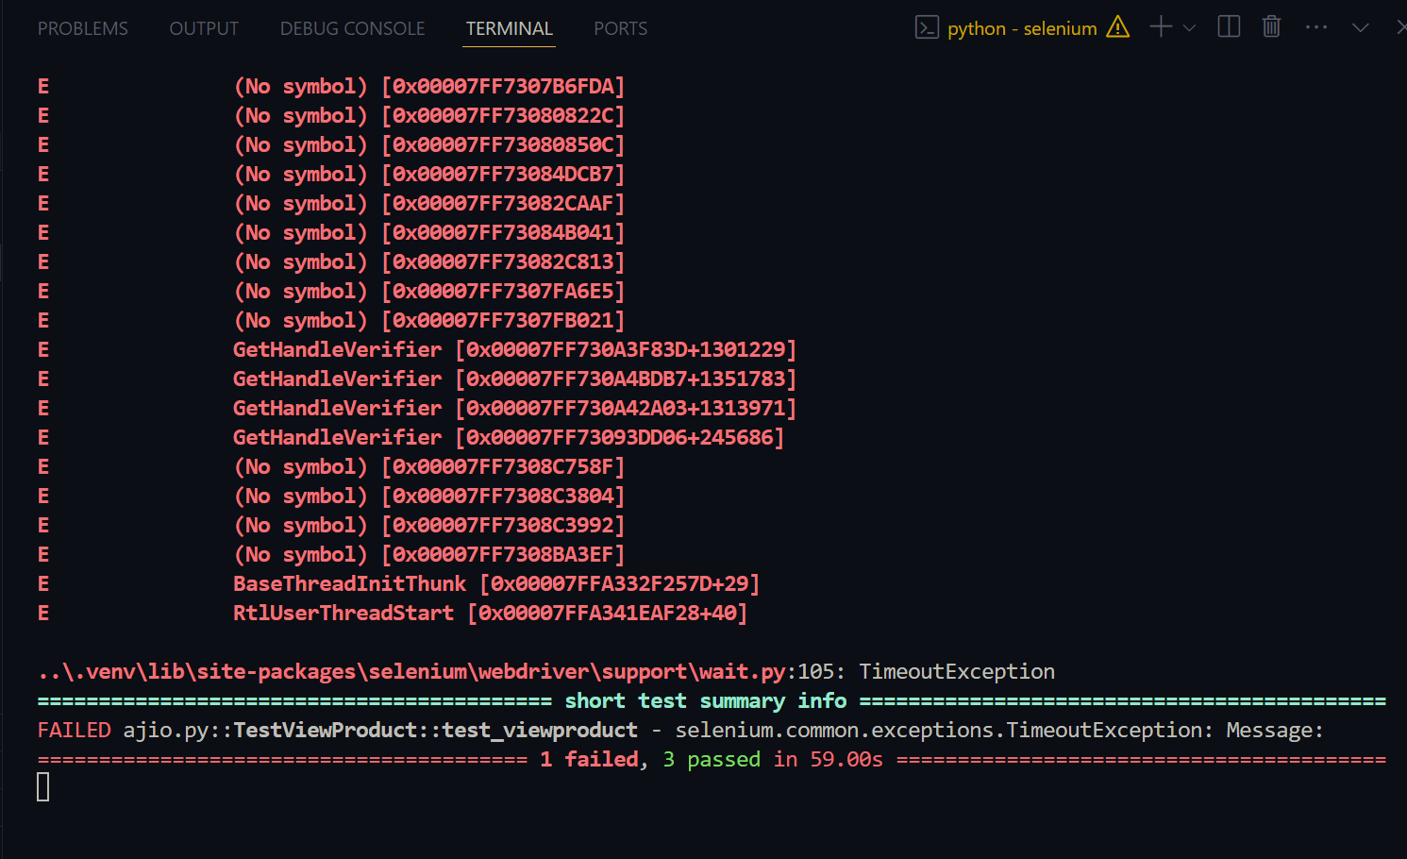
Failing Test Cases

Slide 8
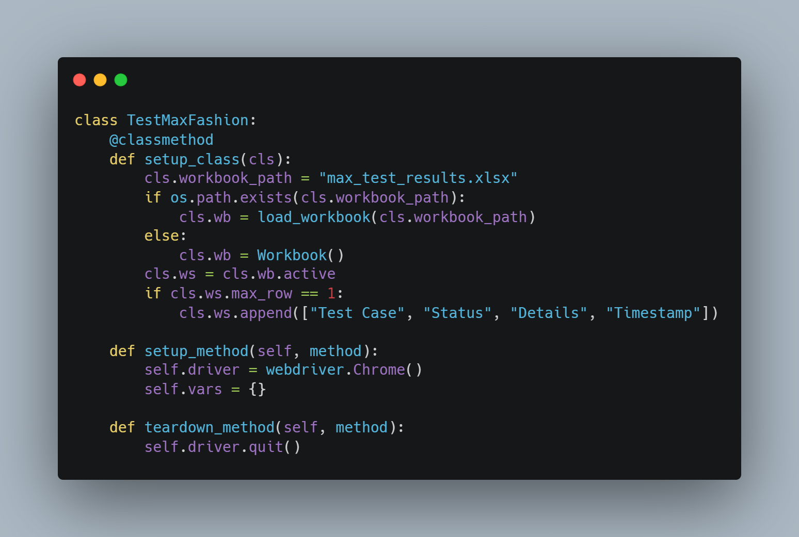
Code Snippet - Setup and Teardown

Slide 9
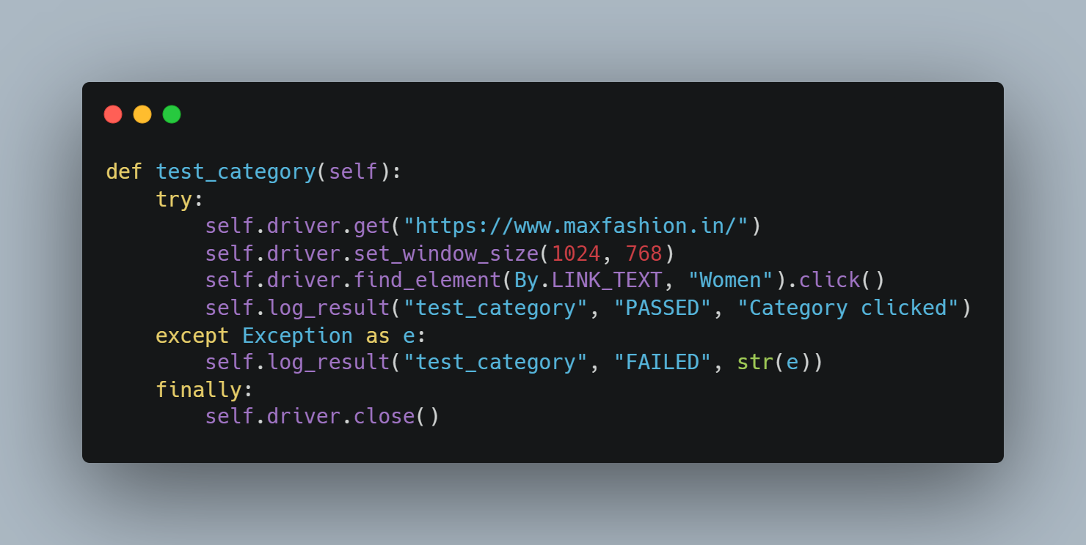
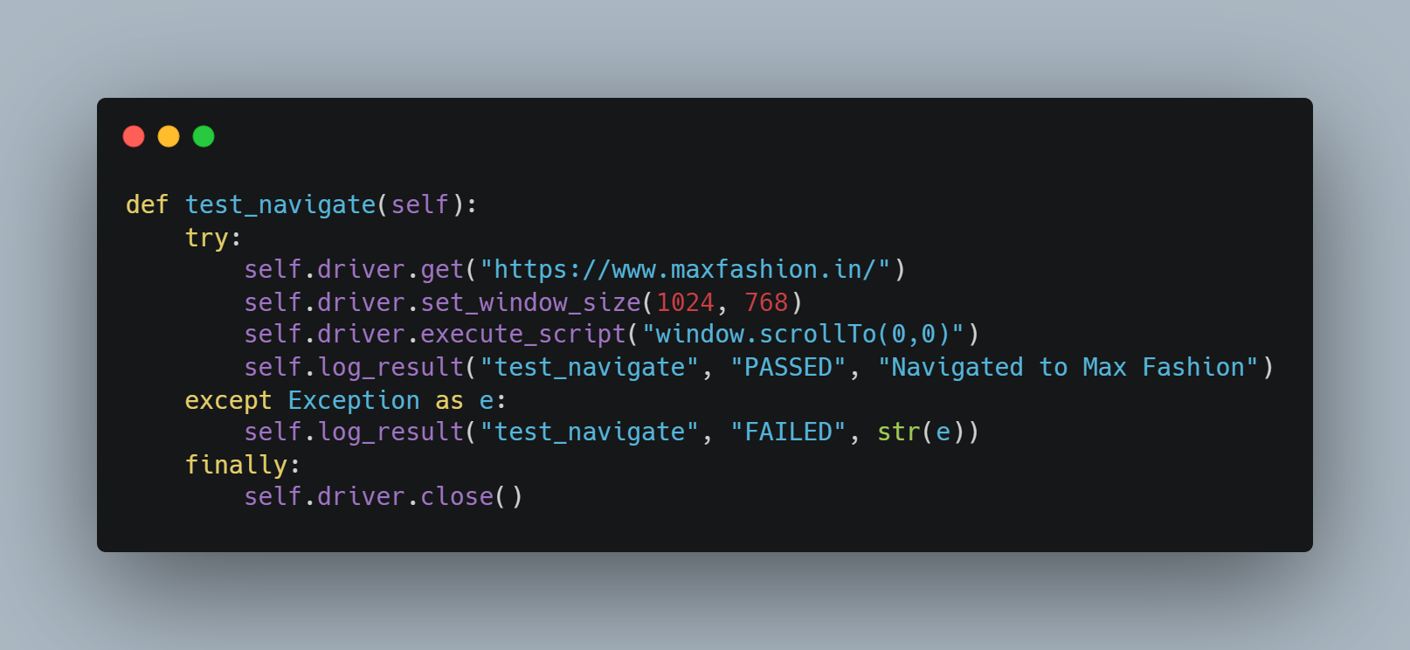
Code Snippet - Navigation & Category Test

Slide 10
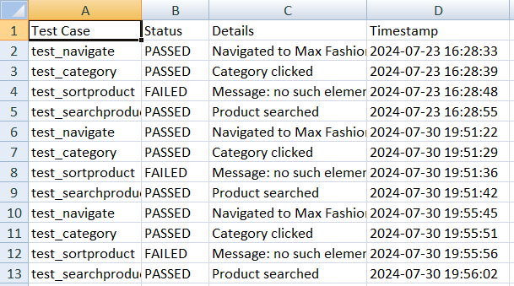
Test Execution and Logging
Activate .venv: source C:/Users/user/ Downloads/selenium/.venv/Scripts/activate
(Optional): pip install pytest selenium openpyxl
Navigate to Test Directory: cd C:/Users/ user/Downloads/selenium/selenium
Tests executed using: python -m pytest max_test.py
Results logged to Excel file:
Test case name
Status (PASSED/FAILED)
Details/Error message
Timestamp

Slide 11
Challenges Faced
Dynamic web elements requiring specific wait strategies
Handling pop-ups and overlays during navigation
Ensuring consistent window size for reproducible tests
Managing test data and results across multiple test runs

Slide 12
Conclusion
Successfully implemented Selenium tests for MAX Fashion website
Covered key functionalities: navigation, category browsing, sorting, and search
Implemented result logging for better test management and analysis
Future improvements:
Implement more comprehensive wait strategies
Expand test coverage to include checkout process
Develop data-driven tests for broader scenario coverage

Slide 13
THANK YOU
PROCEED TO VS CODE

Slide 14
Alternative resources
Here’s an assortment of alternative resources whose style fits the one of this template:
Flat sparkling stars collection
Vector dividers collection in hand drawn style
Vector calligraphic ornamental divider collection

